Slide 1
Legal Structures for Sports Clubs
An informative overview

Slide 2
About Club Development Scotland
CDS formed in 2016
The consultancy arm of Supporters Direct Scotland & working in the sport and governance sector since 2003
Contracted by Scottish Athletics to support member clubs who wish to explore options for incorporation
Currently engaged with 9 athletics clubs

Slide 3
Overview of session
About Incorporation
Legal Structures
CLG
SCIO
CBS
Benefits
Drawbacks
The process of incorporation
Constitution
Side-policies
Asset Transfer
Compliance
Reporting

Slide 4
Legal Structures: Your Current Status and Options
PART ONE

Slide 5
Unincorporated Association
Clubs can either be structured as Unincorporated or Incorporated organisations.
Many sports clubs set up and continue to run as an unincorporated association, bound together by common rules.
An unincorporated association can be well suited to smaller, simpler clubs and they’re easy to set up and are flexible.

Slide 6
Unincorporated Association
However, as an unincorporated organisation, if you enter into contracts, own assets, employ staff or face a claim, for example from an injured participant, all costs and liability could fall on individuals in your club
Typically unincorporated clubs would not employ staff, own significant assets (e.g. land, investments or facilities), enter into significant contracts or look for significant funding opportunities.

Slide 7
Benefits of Unincorporation
Simple administration. Unincorporated associations (unless also a charity) do not have the same legal and administrative requirements that companies have (e.g. the requirement to file accounts or an annual return).
Flexible. The rules of an unincorporated association can be whatever they choose, provided they are lawful, and can be easily updated. Remember the rules of your governing body, or the requirements for grant funding, may need your Constitution to contain certain clauses.

Slide 8
Disadvantages of unincorporated associations
No separate legal identity. An unincorporated association is not separated from its members in the eyes of the law. This means committee members will have to enter into contracts, or hold assets, on behalf of the club, rather than the club itself. In the event of a claim against the club or breach of contract members of the committee, or wider club could be personally liable (especially as public limited liability insurance doesn’t protect in all instances).
Transfer of assets. As assets are held by individuals on behalf of the club, rather than the club itself, they must be transferred if that person leaves the club.

Slide 9
Incorporation
It is important that your club is structured, from a legal perspective, in a way that best suits your needs now and in the future.
If your club is small, doesn’t own any assets, enter into contracts or employ staff, you may wish to remain unincorporated.
If you can’t describe your club in this way, or believe there are additional benefits for your club from incorporating, you might want to consider incorporation.

Slide 10
Limited liability
Limited liability does not offer absolute protection
In extreme circumstances, board members of legal entities can be held personally liable in relation to debts and/or other liabilities, notwithstanding the general principles of limited liability
Such circumstances are extremely rare but may occur when the board members have been reckless or negligent, have acted illegally or outwith their powers; or (in the case of limited companies) where they have caused the company to continue to run up debt beyond the point at which there was no longer a reasonable prospect of avoiding insolvent liquidation

Slide 11
Benefits of Incorporation
As a general rule of thumb, the benefits of being incorporated are:
Limited personal liability (important if your club owns assets or enters into contracts)
Promotes good governance
More formal structure (gives your club increased credibility when viewed externally)

Slide 12
Drawbacks of Incorporation
Process of incorporating (CDS support)
Possibly more administration and formal legal requirements (discussed later)
Directors’ responsibility (discussed later)

Slide 13
1. Choosing a Structure
It’s important to bear in mind that there are different incorporated structures your club could adopt.
Your club could become a:
Scottish Charitable Incorporated Organisation
Cooperative or Community Benefit Society
Community Interest Company
Company Limited by Guarantee

Slide 14
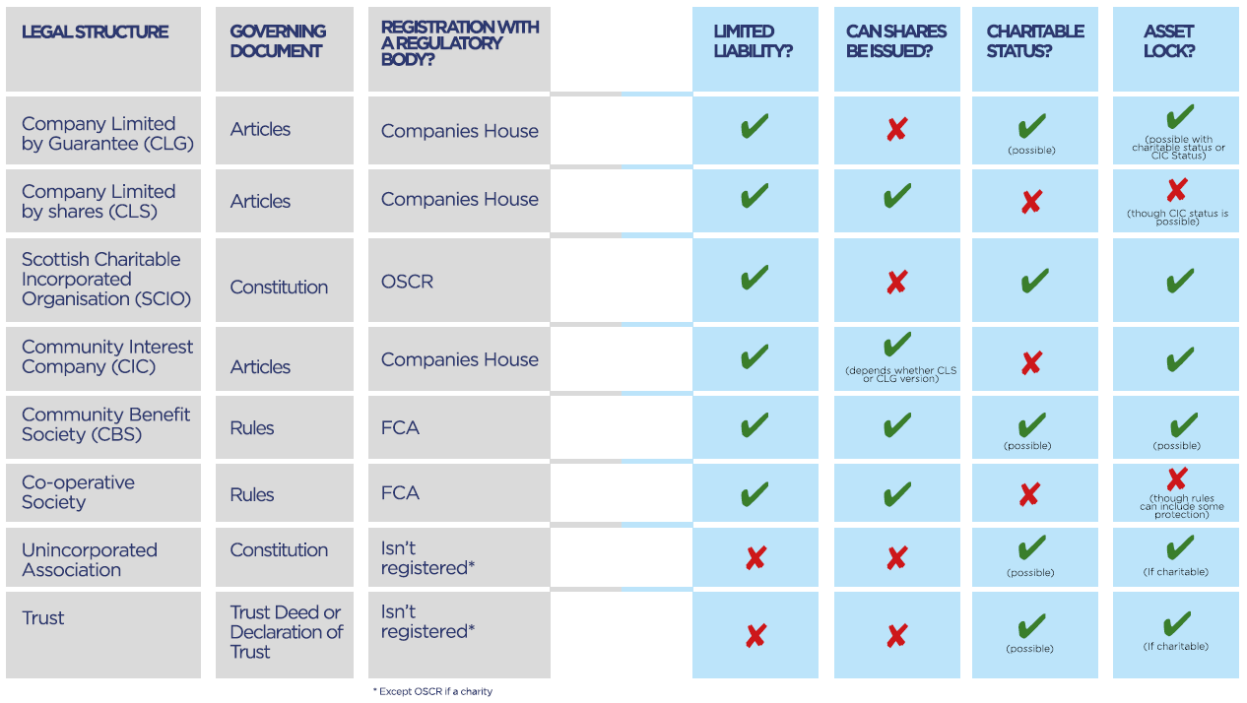
Overview of legal structures

Slide 15
Company Limited by Guarantee
Like an unincorporated association, a club set up as a company limited by guarantee will be owned by its members.
A club set up as a Company Limited by Guarantee will be governed by its Articles of Association and depending on how the articles are written, may qualify for grant funding.
Separate Legal Entity. This allows the club to enter into contracts and hold assets or investments in its own name
Limited Liability. Members are protected and only required to pay an agreed sum (typically £1) if the club becomes insolvent. Having limited liability will protect the directors (of the company) and members against a claim, provided the directors have been compliant with company law requirements.
The main disadvantage of a company limited by guarantee is the additional administrative work needed to comply with legal requirements. These including filing annual accounts, annual returns and providing directors’ information to Companies House. There are fines for missing deadlines. The articles will need careful drafting to protect the club and its assets.

Slide 16
Community Interest Company
A Community Interest Company is a company that operates for the benefit of the community. To become a CIC the company (limited by guarantee or shares) must apply and demonstrate their community benefit. As a company members enjoy limited liability. CICs must meet certain requirements which set out how assets can be used (e.g. asset lock).
An advantage of a CIC include is that it provides a clear, limited company structure, for clubs wanting to be seen as social enterprises rather than a charity. The rules, including the assets lock and community benefit test, provide clarity and focus on what it means to be of benefit to the community.
CICs offer no tax reliefs but have additional administration requirements.
The CIC regulator has more information and step by step guides on CICs. The CIC FAQs may also be of interest.

Slide 17
Community Benefit Society
Cooperative and Community Benefit Societies are types of structure that were previously known as Industrial and Provident Societies. They are reasonably straight forward to set up and provide a separate legal identity for the club and offer protection to members.
For many clubs, a company limited by guarantee is more straightforward to set up and administer. Companies are also more likely to be recognised and understood by external parties (e.g. banks, local authorities).
Cooperative and Community Benefit Societies are regulated by the Financial Conduct Authority (FCA). Refer to the FCA website for more information.

Slide 18
Scottish Charitable Incorporated Organisation (SCIO)
Scottish Charitable Incorporated Organisations are, as the name suggests, organisations that offer the benefits of being incorporated and charitable status in one body.
SCIOs are regulated by one body – OSCR – and therefore can be simpler to administer than clubs set up as a company with charitable status. The latter would have obligations to both Companies House and the Charities Commission.
In order to register as a SCIO, the objects must be exclusively charitable and meet the public benefit test.

Slide 19
Advantages of incorporation as a SCIO
A Scottish Charitable Incorporated Organisation (SCIO) is a legal form available to Scottish charities
A SCIO is a corporate body that can enter into contracts, employ staff, incur debts, own property, sue, and be sued
It provides a high degree of protection against personal liability for its charity trustees, and provides reassurance for those entering into contracts with it
Compared with incorporation as a charitable company, the requirements for financial reporting are less onerous (and are identical to those which apply to unincorporated charities)
Gift Aid

Slide 20
Athletics Clubs as SCIOs
30 athletics clubs in Scotland who are either a SCIO or are in the process of changing their legal status.
A few, but not exclusively, who have changed/are changing are (The majority of these clubs have made the change within the last 5 years):
Harmeny AC
Team East Lothian AC
Bellahouston Road Runners
Lasswade AC
Dundee Hawkhill Harriers (in process)
Kilmarnock Harriers
Kilbarchan AAC
Garscube Harriers
Chirnside Chasers AC
Gala Harriers AC
Livingston AC
Edinburgh AC
Victoria Park City of Glasgow AC
Whitemoss AAC
Giffnock North AC
North Ayrshire AC

Slide 21
Overview of the SCIO registration process
Decide on legal structure
Propose / discuss with members
Draft constitution
Vote at EGM
Application to OSCR
If successful, OSCR will enter the SCIO in the Scottish Charity Register
Transfer assets to the newly SCIO
Register for Gift Aid claiming with HMRC
Dissolve the unincorporated club (following the old constitution)

Slide 22
The Charity Test
The charity test is the legal set of requirements that an organisation must pass to become a charity and be entered in the Scottish Charity Register. The charity test is in two main parts – an organisation has to show:
that it has only charitable purposes
that it provides public benefit in achieving those purposes
Public benefit is what your organisation must provide to satisfy the Charity Test. We will need to be satisfied that your organisation will make a positive difference for the public.
The charity test also states that an organisation cannot become a charity, or continue to be one, if its governing document allows it to use its assets (cash or property) for non charitable purposes

Slide 23
Sports clubs as charities
Many grassroots clubs have broad objectives and carry on activities which could potentially be charitable e.g. running a football club for children or disabled people.
In some cases the club may simply need to amend its constitution to ensure it is consistent with the requirements of a charity.
Larger semi-professional clubs may not be eligible for charitable status if, for example, they pay their players a playing fee (although other options may be available).

Slide 24
Charitable Status
Adopting charitable status may benefit your club, but it also brings with it additional requirements.
You will need to meet certain rules to be eligible to become a charity and meet ongoing annual reporting requirements.
Most clubs including those set up as unincorporated associations, companies limited by guarantee and community benefit societies can be charities.
A CIC and non-charitable community benefit societies cannot be a charity but exist to benefit the wider community by trading to make a profit. As the name suggests, a Scottish Charitable Incorporated Organisation must be a charity and if it loses it’s charitable status, will revert to an unincorporated association.

Slide 25
Disadvantages of Charitable Status
Administration. Regulation by the Charity Commission can involve an additional administrative burden.

Slide 26
Advantages of Charitable Status
Advantages of charitable status include:
Tax reliefs. Charities attract considerable tax advantages on charitable expenditure including trading profits, rental income, on profits if you sell an asset and when you buy property. A club will also benefit from 80% relief from Business Rates.
Fundraising. People may view you differently as a charity. Charities often enjoy considerable support from funders and other potential supporters and can claim Gift Aid on donations.
Other benefits. Amazon Smile, Easy Fundraising, Google Grants, TT-Exchange

Slide 27
What changes?: Compliance/accounts and reporting

Slide 28
Annual reporting / annual returns
This is a responsibility of all trustees, not just the treasurer, secretary or chair – and must be done on time (within 9 months of year end)
Annual return
A legal requirement
The numbers
Annual report
A legal requirement
Also an opportunity to tell your story, and demonstrate the difference you have made in the last year
Connects the activities to your charitable purposes
WHY your charity was set up
WHO your charity helps
WHAT was done, what was achieved, and what difference was made

Slide 29
Financial Reporting
You must prepare your charity's accounts in one of two ways, depending on the size of its income, its legal form or how its constitution is worded.
Receipts & Payments
Receipts & payments accounts are a simple form of accounting that consist of a summary of all monies received and paid via the bank and in cash by the charity during its financial year, along with a statement of balances.
This applies to charities with a gross annual income under £250,000 that are not companies, however, if:
your charity's constitution says it should prepare accrued accounts
your charity's trustees have taken a decision to prepare accrued accounts, or
any enactment says that you should prepare accrued accounts,
then you must prepare accrued accounts even if your charity's gross income would otherwise allow accounts to be produced on a receipts & payments basis.
Accruals
Accounts prepared using the accruals basis allocate the costs or income of a particular activity according to when the liability is incurred, or when there is entitlement or certainty about income. This is not necessarily the date on which money is received or paid out.

Slide 30
Independent Examination
The independent examination of receipts and payments accounts must be carried out by someone independent of the management and administration of the charity and whom the charity trustees believe has the required skills and experience to carry out a competent examination of the accounts

Slide 31
Reporting
One of the key differences as a charity would be the requirement to report on your activities/finances and the availability of this information.
The following slides show the publicly available information about a charity registered with OSCR.

Slide 36
THANK YOU

